Slide 1

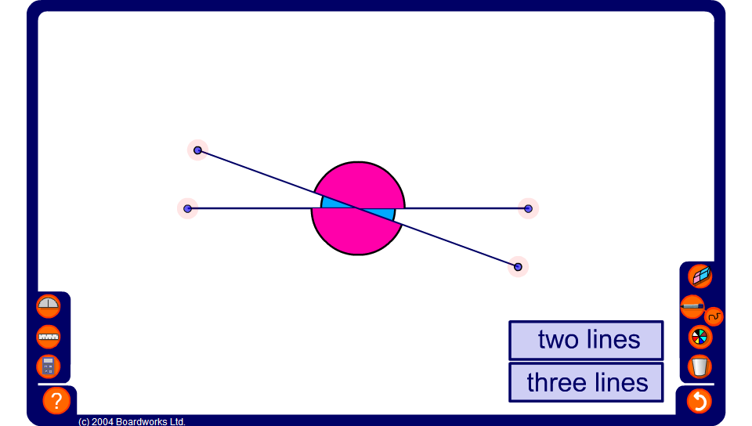


Intersecting lines
Notes:
Use this activity to demonstrate that vertically opposite angles are always equal.

